Slide 1

IS5151 Information Security Policy and Management
Group 3
JAGADEESH CHIRUMAMILLA | LI JIACHEN MADDI KAMAL DIVYA | ROHAIZAD BIN NOORDIN XU HAODI | YARE FENG SHUI

Slide 2

Case Discussion
California Consumer Privacy Act
Seeks to protect users’ data privacy by imposing new rules on companies that gather, use, and share personal data.
The law will go into effect in Jan 2020.
As the rest of the U.S. stands by and watches, California has become the leader in consumer data privacy protection that many other states will soon follow.
The right to be informed about what kind of personal data companies have collected and why it was collected.
The law stipulates that consumers have the right to request the deletion of personal information, opt out of the sale of personal information, and access the personal information in a “readily useable format”.

Slide 3
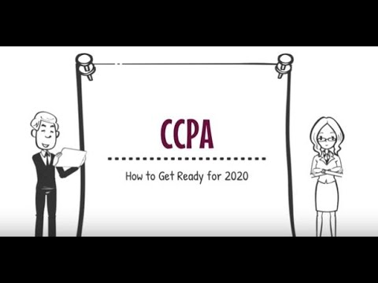

Slide 4



Q1) Who is protected under CCPA and who should comply with CCPA
The consumer who is California resident is protected under CCPA
The California business of substantial size (with regard to revenue or number of consumers affected) that collect consumer personal data should comply with CCPA

Slide 5

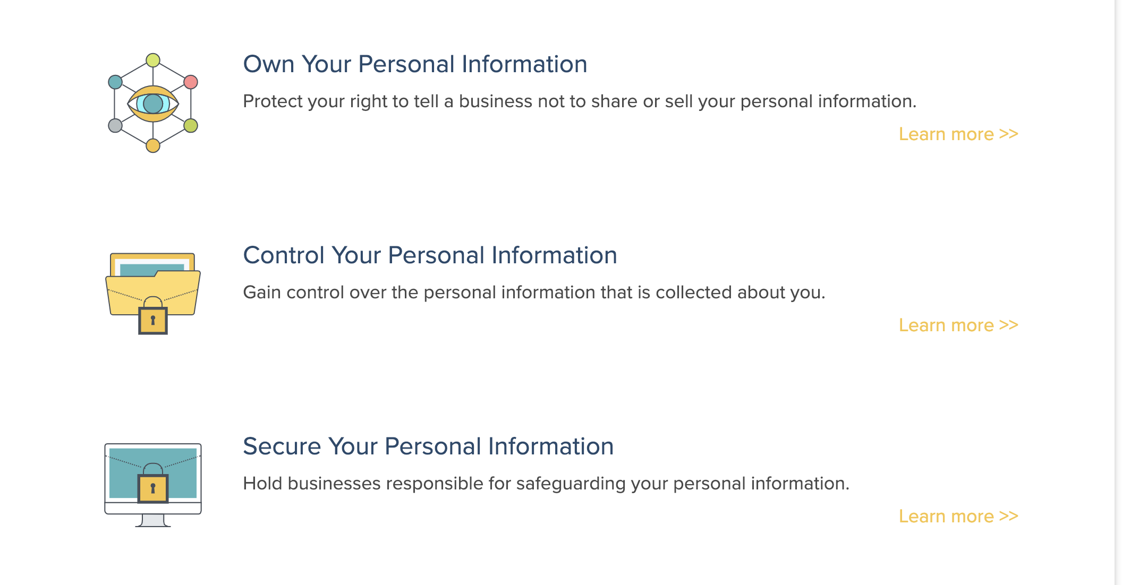
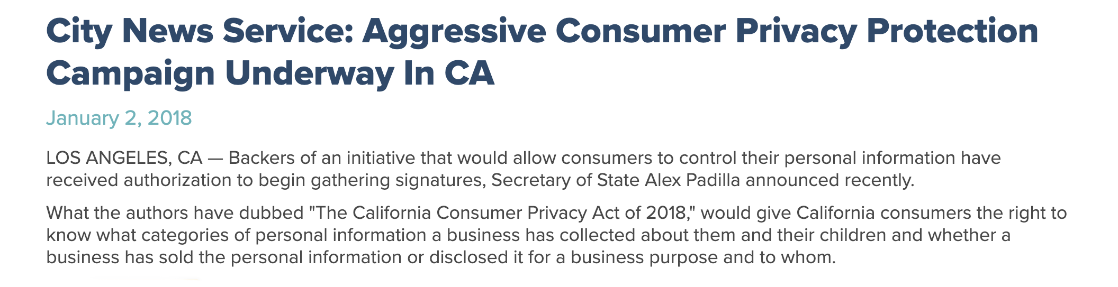
Q1) Who is protected under CCPA and
who should comply with CCPA?
Own Your Personal Information
Protect your right to tell a business not to share or sell your personal information.
The California Consumer Privacy Act empowers you to find out what information businesses are collecting about you, your devices, and your children, and gives you the choice to tell them NO.

Slide 6
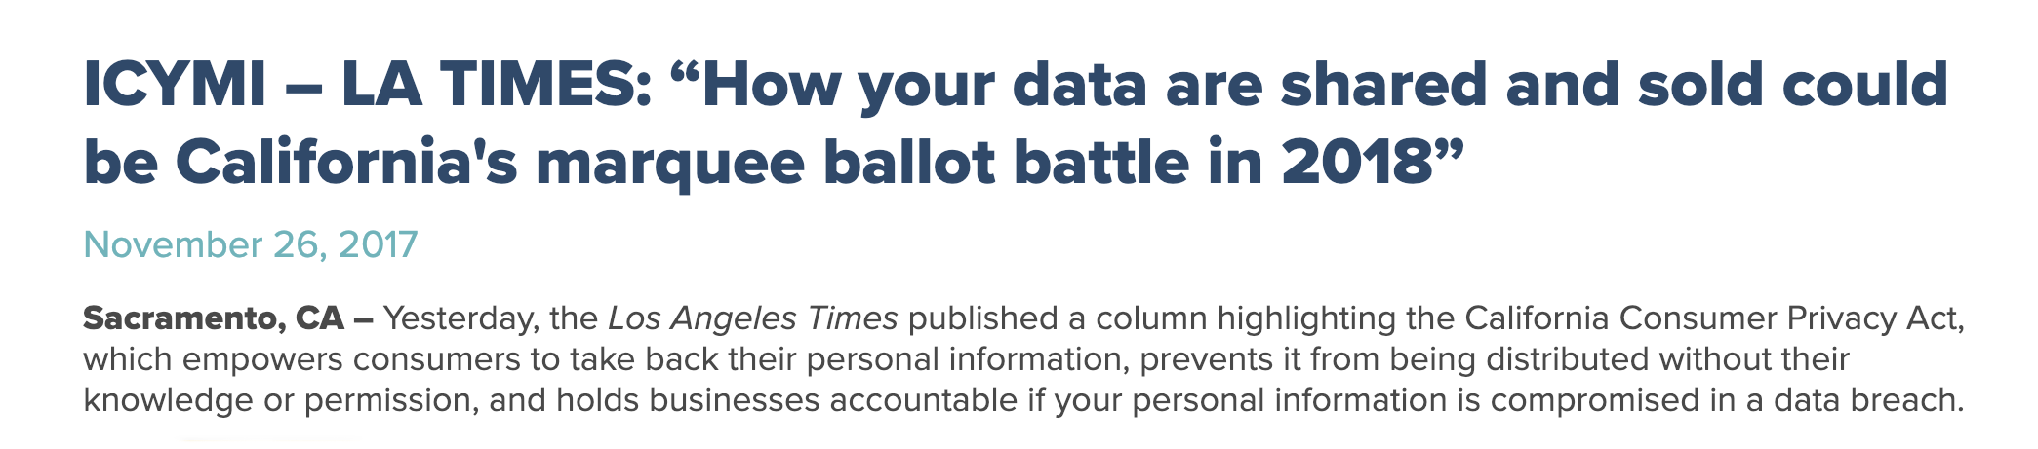
Q1) Who is protected under CCPA and
who should comply with CCPA?
Control Your Personal Information
Gain control over the personal information that is collected about you.
The California Consumer Privacy Act protects you from being discriminated against if you tell companies to stop selling your personal data. If you tell a business not to share or sell your private information, they cannot charge you more, deny you access to services, or change the quality of the service you get.

Slide 7
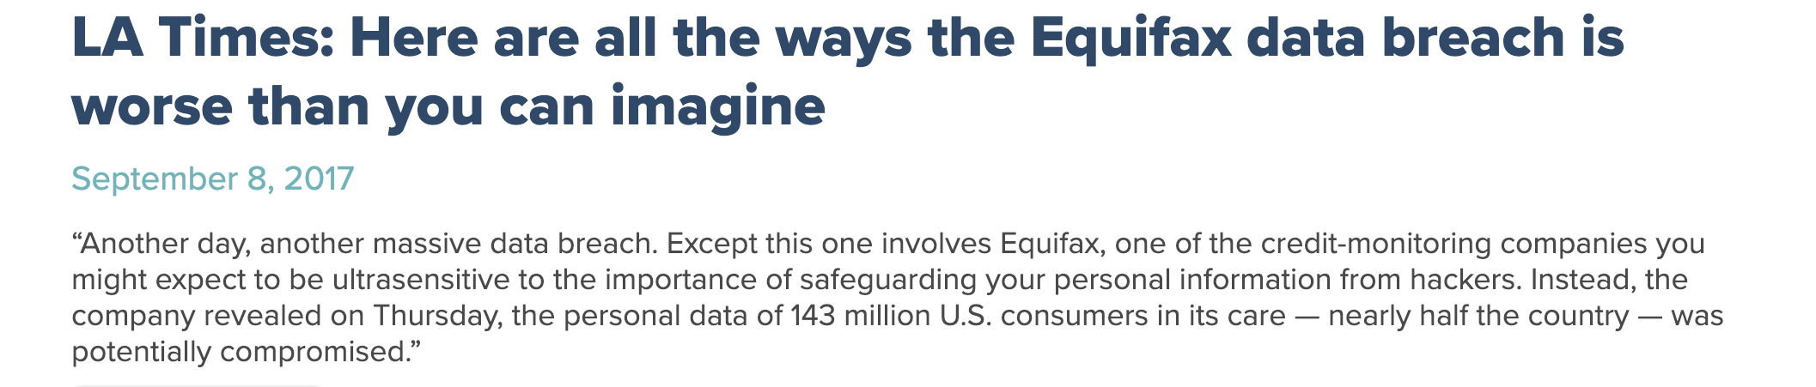
Q1) Who is protected under CCPA and
who should comply with CCPA?
Secure Your Personal Information
Hold businesses responsible for safeguarding your personal information.
As we have seen with the many breaches of personal information, businesses ignore the current law. The California Consumer Privacy Act increases fines and penalties for violations of existing law so that you can hold businesses responsible for safeguarding your personal information if the business chooses to collect it.

Slide 8

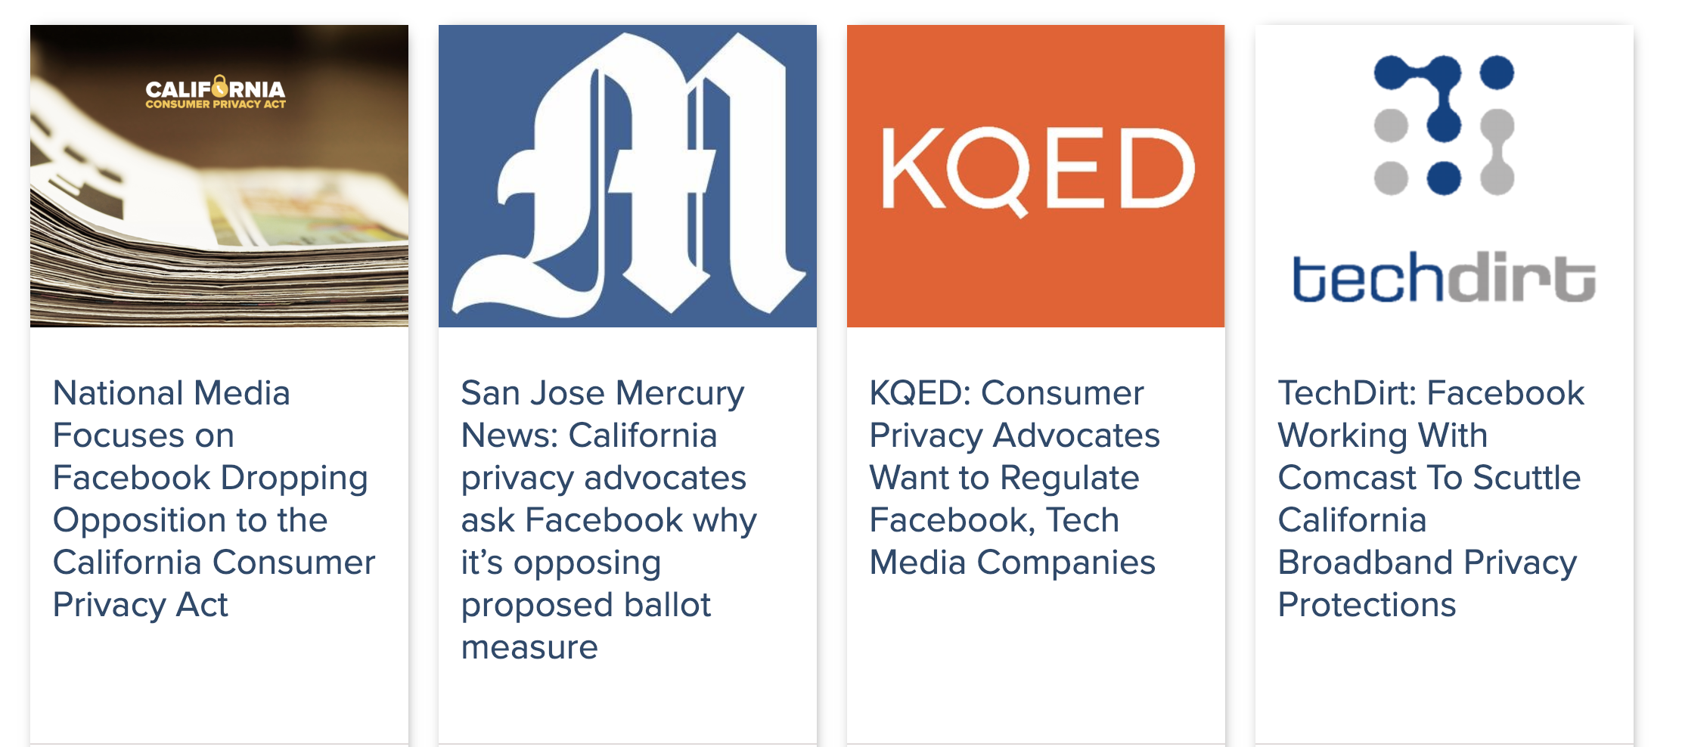
Q1) Who is protected under CCPA and
who should comply with CCPA?
Hold Big Corporations Accountable.
Only really big businesses are covered by the CCPA, and data brokers whose entire business model revolves around the sale of your personal information.

Slide 9
Q2) The key regulations highlights in CCPA
1
2
3
4
5
The Right to Know
The Right to Opt Out
The Right to Deletion
The Right to Equal Service
The Right to Access
Notes:
The Right to Know: the right to know, through a general privacy policy and with more specifics available upon request, what personal information a business has collected about them, where it was sourced from, what it is being used for, whether it is being disclosed or sold, and to whom it is being disclosed or sold;
The Right to Opt Out: the right to “opt out” of allowing a business to sell their personal information to third parties (or, for consumers who are under 16 years old, the right not to have their personal information sold absent their, or their parent’s, opt-in);
The Right to Deletion: the right to have a business delete their personal information, with some exceptions; and
The Right to Equal Service: the right to receive equal service and pricing from a business, even if they exercise their privacy rights under the Act.
The Right to Access: Consumers also have the right to request certain information from businesses.

Slide 10
What is Personal Information to you?
Personal Purchasing Habits and History
Personal Computer Mac Address and its IP address
Email Address
Mobile IMEI Number and its IP address
Notes:
Before we move on the what is defined as Personal Information in CCPA, I would like to ask everyone’s opinion on What is considered personal information to you. Do you consider Personal Purchasing Habits as personal Information? (Raise your hand if you consider it as Personal Information.) Do you consider Personal Computer Mac Address and IP address as Personal Information? (Raise your hand if you consider it as Personal Information.) Do you consider Mobile IMEI Number and its IP address as Personal Information? (Raise your hand if you consider it as Personal Information.)
Why do you think ____ is considered as personal information?
How many of you all are comfortable sharing all these information with others? Can I have a show of hand?
Why are you not comfortable sharing? Or why are you comfortable sharing it?
Conclusion: There is no right or wrong answer to it. Everyone has their own comfortable level in sharing certain information and some information may be deemed as personal to you, may not be personal to others. Some of these information that may seems non personal, could be combined and form Personal Information. Take for an example, if you store all your credentials, bank account in your computer. When a hacker is aware of some of your information, hacker could easily perform phish for your other important information or hack into your system.

Slide 11

Q3) According to CCPA, what is considered as “personal information” that needs protection?
“Personal Information” is defined as
“information that identifies, relates to, describes, is capable of being associated with, or could reasonably be linked, directly or indirectly, with a particular consumer or household.”
Personal information does not include information that lawfully is made available from federal, state or local government records that is used for a purpose that is compatible with the purpose for which such data is so maintained.
Notes:
To address the above-mentioned issue, CCPA actually have refined Personal Information. Given this is the definition on the slide, we only need to take note on the one that is being underline. “identifies, relates to, describes, is capable of being associated with, or could reasonably be linked”. “directly or indirectly” to “consumer or household”. Take note of the additional “household” term here, information that is capable of point to our home is also classified under personal information in CCPA.
However, CCPA does not include information that is issue by government and that information provided must be made known to the public. For instance, National Identity Card is considered as Personal Information as it is not made known to public but is issue by the government. Government hotline, office address and etc will not be considered as Personal Information.

Slide 12
Q4) Comparing CCPA and PDPA 2012, identify THREE dissimilarities between these two regulations. Comments on them.
Implementation
CCPA
Will be implemented in California
Signed into law by California on June 28, 2018
Effect beginning January 1, 2020
PDPA
Already implemented in Singapore
Assented on 20 November 2012
Full effect on 2nd July 2014
Notes:
How many of you know about PDPA?
Do you know about DNC? Have anyone resgistered? Is it effective? (or in later slides if there is time)
Do you think CCPA is very different from GDPA or PDPA?
-----Discussion----
Personal data in Singapore is protected under the Personal Data Protection Act 2012 (PDPA).
governing the collection, use, disclosure and care of personal data. It recognises both the rights of individuals to protect their personal data, including rights of access and correction, and the needs of organisations to collect, use or disclose personal data for legitimate and reasonable purposes.
Do Not Call (DNC) Registry llows individuals to register their Singapore telephone numbers to opt out of receiving marketing phone calls, mobile text messages such as SMS or MMS, and faxes from organisations. Comments:
In order to avoid last-minute compliance scrambles as effective dates are close, it's also worth keeping an eye on new privacy laws on the horizon.

Slide 13
Extra-Territorial Jurisdiction
CCPA
Applicable to for-profit businesses that collect and control California residents’ personal information, do business in the State of California.
If every aspect of commercial conduct takes place wholly outside of California
PDPA
Applicable to any organization in Singapore processing personal data from anywhere, and organizations outside of Singapore processing personal data from individuals in Singapore.
The PDPA does not define "organization" or "personal data" in terms of geographical location.
Notes:
Do you think CCPA is very different from GDPR or PDPA?
CCPA just covers California currently but they expect large companies will soon have to offer similar rights to Americans. PDPA - not in terms of geography

Slide 14
Penalties
CCPA
PDPA
The california Attorney General may impose civil penalties of up to $7,500 per intentional violation.
Private right of action for data breaches ($100-$750)
But 30 day cure period
Fines not exceeding S$5,000-10,000 (depending on the offence) or imprisonment of up to 12 months for the individuals in breach of policy
Fines not exceeding S$50,000 - 100,000 (depending on the offence) for the organisations
Notes:
Do you think the penalties will avoid the data breach? Is it sufficient amount of penalty?
CCPA gives flexibility to organisation with a limited cure period.
In CCPA there is a cure period for which customer has to give violating business 30 days advance notice. If the business cures the alleged violation within 30 days and provides a written statement that violation has cured and never occur, the lawsuit cannot be filed.

Slide 15
Right to be object
CCPA
Consumers have a right to opt out of the "sale" of their personal information, greater control over data-sharing
PDPA
Individuals has right to withdraw their consent but opt out from “sale” of their personal data is not mentioned.
Notes:
------DNC services--- CCPA has given greater control to the consumer. The consumer has the right to opt out from the “sale” of his information incase he has given consent to sell his information.

Slide 16
Right of Equal Service
CCPA
The right of Californians to equal service and price, even if they exercise their privacy rights.
PDPA
Right of equal service is not specified.
Notes:
If a consumer has not given any consent to use his information or sell which means he is using his rights (business won’t get much benefit from that consumer), still the business should provide the same quality of service and price to the consumer

Slide 17
Right to be Forgotten
CCPA
The right to have a business delete their personal information, with some exceptions
PDPA
Organizations are obligated not to retain personal data if it is no longer required for the purpose for which it was collected, and if there are no business or legal reasons to retain it.
Notes:
PDPA mentions that personal data can only be retained for business/legal purposes and securely destroy personal data when no longer needed. Whereas CCPA doesn’t talk about retention and deletion of the collected data but provides rights to the consumer to delete their information from business anytime. -------------Discussion------------------- So, what do you guys think?
which one is better?
It depends on the business requirements of the company, the lifestyle habits of the individuals in the country. The newly implemented acts have considered many other criterias before finalizing the acts and may be it sounds advanced.
So, time was given for the businesses to prepare for the new act.
Till the act is implemented, we cannot comment on the advantages and disadvantages of the act. But as advertised CCPA has taken bold steps in establishing new, groundbreaking consumer privacy rights

Slide 18
Q & A

